Slide 1
SYSTEM ANALYSIS PROJECT
THE ANALYSIS COMPANY: GOBUS

Slide 2
PROJECT DESCRIPTION
The GoBus system design project is a transformative initiative aimed at addressing the pressing challenges faced by GoBus, a prominent public transportation company operating in Egypt, Saudi Arabia, and Jordan. The company, established in 1998, has been a pioneer in the private transportation sector, providing luxury and standard travel options to diverse customer segments. Despite its initial success, GoBus is now grappling with critical issues, including declining revenues, operational inefficiencies, and customer dissatisfaction.

Slide 3
PROJECT SCOPE AND OBJECTIVES
The primary objective of this project is to overhaul GoBus’s operational and reservation systems to enhance customer satisfaction, streamline business processes, and increase revenue. This will be achieved by developing a state-of-the-art, integrated digital platform that incorporates modern software engineering practices, robust data management techniques, and customer-centric designs.
Key challenges identified during the analysis include:
Double Bookings: Instances of passengers booking the same seat through multiple outlets due to manual coordination processes.
Revenue Decline: A noticeable reduction in ticket sales, compounded by limited accessibility to reservation services.
Customer Dissatisfaction: Overcrowding and poor user experiences due to the lack of real-time seat availability tracking and online services.

Slide 4
To address these issues, the proposed system will include the following features:
Automated Reservation System: Elimination of manual coordination by integrating all booking outlets with a centralized database.
Online Ticketing Platform: A web and mobile application allowing passengers to book tickets, view schedules, and monitor seat availability in real-time.
Occupancy Tracking: A system for tracking real-time bus occupancy to prevent overbooking and enhance operational efficiency.
Budget Management Tools: Automated financial reporting and budget allocation to support operational transparency and accuracy.
Enhanced Customer Experience: Multi-channel access (web, mobile, in-terminal kiosks) and added conveniences such as loyalty programs and dynamic pricing.

Slide 5
Some additional Technical problems that can be fixed:
Phone Number Requirement
Problem: Account creation requires an Egyptian phone number, limiting international users.
Solution: Allow international phone numbers or offer alternative authentication methods like email or social login.
Missing Facility Information
Problem: Users can’t see bus facilities (e.g., Wi-Fi, toilets) when booking.
Solution: Display facility icons and add a bus class comparison feature during booking.
Seat Selection Issues
Problem: Limited or unclear seat selection options frustrate users.
Solution: Improve seat selection features, showing seat types, pricing.
Poor Feedback and Complaint System
Problem: Users cannot report or resolve issues like poor facilities and rude staff.
Solution: Integrate an in-app feedback system to report issues, request refunds, and lodge complaints.
https://thirdeyetraveller.com/gobus-egypt-review-tourist/

Slide 6
Strategic Benefits
The implementation of this system is expected to yield significant improvements:
Operational Efficiency: Automation of processes will reduce errors, improve coordination among departments, and enhance service delivery speed.
Revenue Growth: The introduction of an online platform will expand the customer base and provide new revenue streams.
Customer Retention: Improved service quality and convenience will enhance customer satisfaction, fostering loyalty.

Slide 7
2. System Technical Architecture (STA)
The STA defines the foundational framework and technologies required for the system. It ensures scalability, reliability, and security while meeting business objectives.
Components of the Architecture
Centralized Computing Model:
A centralized architecture ensures consistent data management, easy maintenance, and reduced redundancy. All booking outlets, mobile applications, and the web platform will connect to a single, robust database system.
Data Storage and Management:
Database: A relational database (e.g., PostgreSQL or MySQL) will store all essential data, including passenger records, booking information, and financial transactions. It will feature:
Data encryption for sensitive information (e.g., payment details).
Partitioning for efficient data retrieval across different modules (e.g., booking, budgeting).
Backup System: Automated daily backups to a cloud service (e.g., AWS or Azure) to ensure data availability during failures.

Slide 8
Development Environment:
Backend Technology: The system will use a robust backend framework such as Node.js or Django for high performance and scalability.
Frontend Technology: React.js will ensure responsive and interactive user interfaces.
Mobile Application Framework: Flutter will enable cross-platform mobile app development for Android and iOS.
Network Design:
A secured Virtual Private Network (VPN) will connect the central database to all outlets.
API Gateways: Facilitate secure communication between subsystems (e.g., payment gateways, external analytics tools).
User Interfaces:
Customer Interface: A sleek web and mobile design with intuitive navigation for booking tickets, viewing trip details, and managing profiles.
Admin Interface: A dashboard offering tools for operations monitoring, reporting, and data management.
Security Measures:
Two-factor authentication for user accounts.
Role-based access control (RBAC) to restrict sensitive functions to authorized personnel.
Intrusion detection systems to monitor and block unauthorized activities

Slide 9
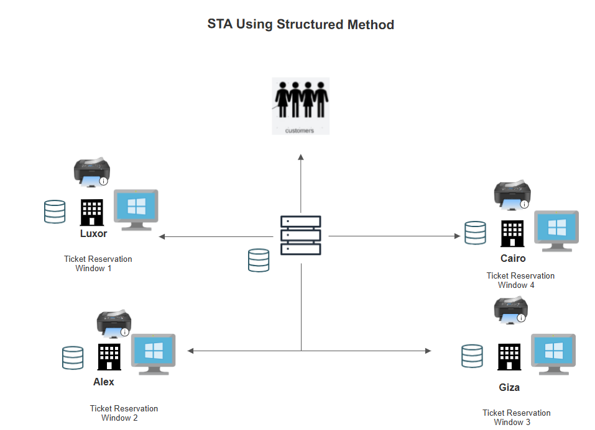

Slide 10
SYSTEM ARCHITECTURE:
Will the system use centralized or distributed computing? | Centralized | Centralized architecture ensures seamless coordination across booking outlets and digital platforms.
Will the system use centralized or distributed storage? | Centralized | A centralized relational database will handle all ticketing, user, and operational data, ensuring consistency.
Selection of operating system | Windows and Linux | Windows for the admin dashboard and outlets, and Linux for backend servers to ensure scalability.
How will users interface with the system? | Dialogue with user | Web applications, mobile apps, and admin dashboards with interactive forms and menus.
What data storage technology will be used? | Relational Database (SQL) | A relational database (e.g., MySQL/PostgreSQL) for structured data storage, ensuring fast queries and integrity.
Will software be purchased, built in-house, or both? | Both | Critical modules will be custom-built in-house (e.g., reservation system), with third-party integrations for payment and analytics.
What technology will be used for software building? | C# | The backend logic and APIs will be developed using C# with the .NET framework. Mobile apps will be built using Flutter for cross-platform compatibility.
How will the system interface with legacy systems? | No legacy systems | The system is designed as a standalone architecture with no dependency on outdated legacy systems.
How will initial data be loaded? | Screens/Forms | User-friendly forms and admin portals for loading passenger, route, and operational data.
How will output data be generated? | Screens/Printing | Data will be presented through dashboards, reports, and printable tickets for operational and user purposes.

Slide 11
3. Input Design
The input design emphasizes user convenience, accuracy, and system reliability. Inputs will be categorized and designed to align with operational needs and enhance user experience.
Input Categories:
Customer Inputs:
Fields: Name, email, Phone Number, travel route, departure and Destination, Date and time, payment information.
Input Mechanisms: Drop-down menus for routes, date pickers for schedules, and secure text fields for card details.
In-Terminal Inputs:
Touch-screen inputs for booking tickets and selecting seats.
Payment integration with QR code scanning for cashless transactions.
Admin Inputs:
Budget allocation forms with predefined fields for departments.
Tools for adding, updating, or deleting routes and schedules.

Slide 12
4. Output Design
Outputs are designed to meet both customer and organizational needs. They will be visually appealing, timely, and relevant.
Output Categories:
Customer Outputs:
E-Tickets: Delivered via email and app notifications with detailed travel information (departure time, seat number, QR code for scanning).
Real-Time Notifications: Alerts for changes in schedules, delays, or cancellations.
Admin Outputs:
Operational Reports: Live dashboards showing occupancy rates, route performance, and daily booking summaries.
Budget Utilization Reports: Visual breakdowns of expenses and revenues.
Strategic Outputs:
Predictive analytics dashboards for forecasting demand.
Route heatmaps for optimizing bus schedules and marketing efforts.

Slide 13
Input, output and interface Design

Slide 14
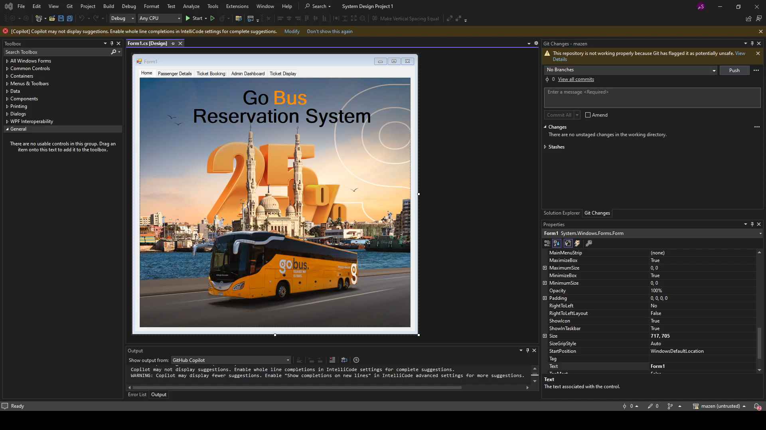

Slide 15
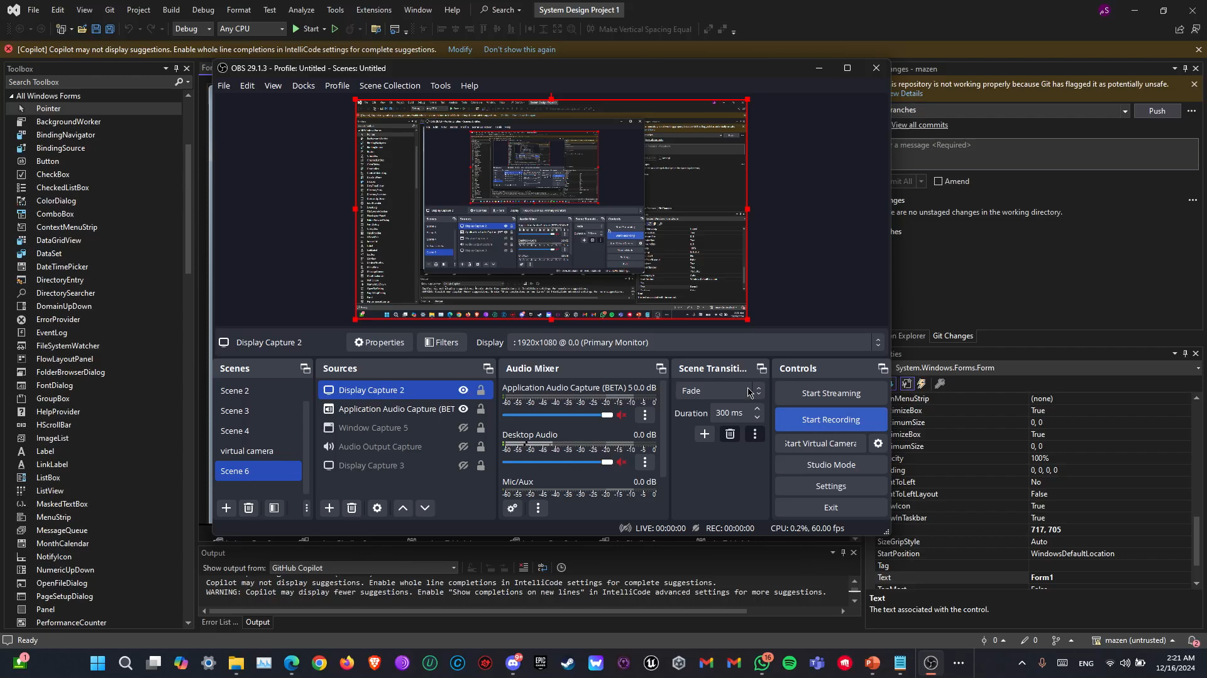

Slide 16
database design (ERD + Schema)

Slide 17
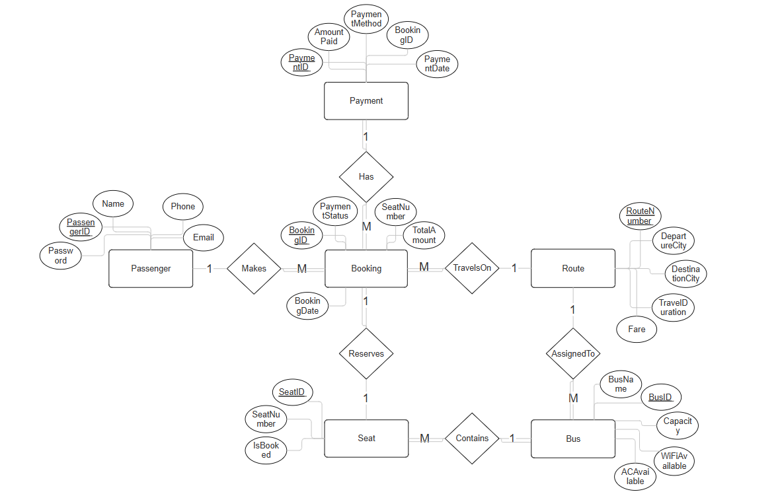

Slide 18
